Slide 1

Please silence your cell phones
SOE Guest Wifi Password:
OrangeElection$

Slide 2

Welcome to the
2024
Candidate Seminar
Presented by the Orange County Supervisor of Elections Office
NOTICE: This slide presentation will be made available on our website for future reference.

Slide 3
Voter Registration
& Book Closing
Presenter
Lucy Melendez Director of Voter Services

Slide 4
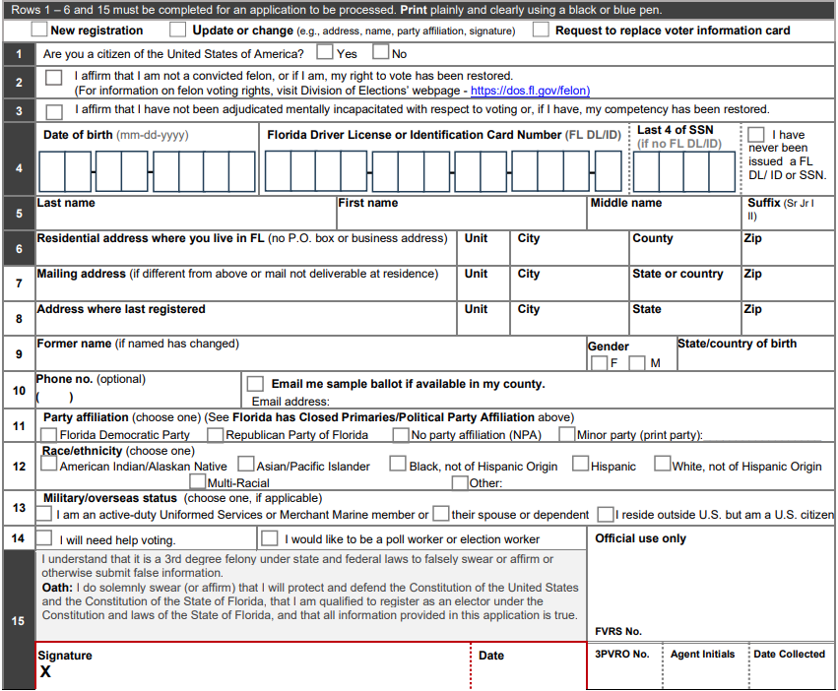
Registration Resources
New Voter Registration Application Form:
April 2024
Online Voter Registration: RegisterToVoteFlorida.gov
Driver License Office
Public Library
Center for Independent Living
WIC and DCF Offices
Election Office

Slide 5
Who must register as a 3PVRO? FS. 97.0575
Any person or entity, or organization that collects or handles any completed or otherwise non-blank voter registration application (VRA) form.
    Candidates
    Political Committees
    Political Parties
    Subsidiary or affiliate of a registered 3PVRO
Complete DS-DE 119
10 days (or prior to registration deadline) to return completed applications
For more information:
Division of Elections
Email:
3PVRO@dos.myflorida.com
Phone:
(850) 245-6290

Slide 6
Registration Deadline
“Book Closing”
29 days before an election
  New registrations
  Party changes prior to a partisan primary
Primary Election – August 20, 2024
Book Closing – July 22, 2024 * CLOSED PRIMARY *
General Election – November 5, 2024
Book Closing – October 7, 2024

Slide 7
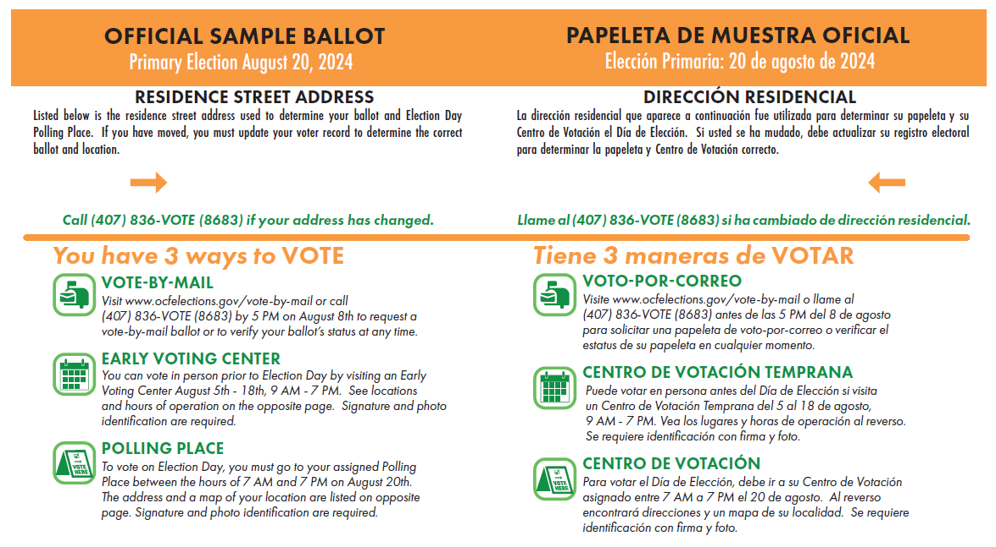
Official
Sample Ballot
July 29, 2024

Slide 8
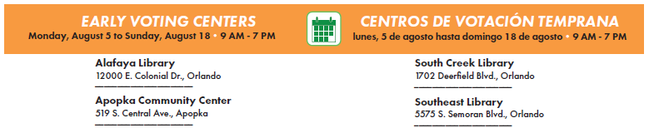
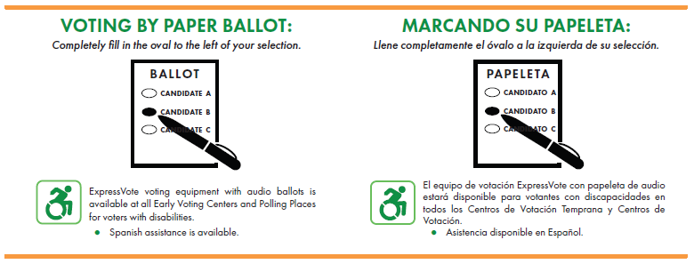
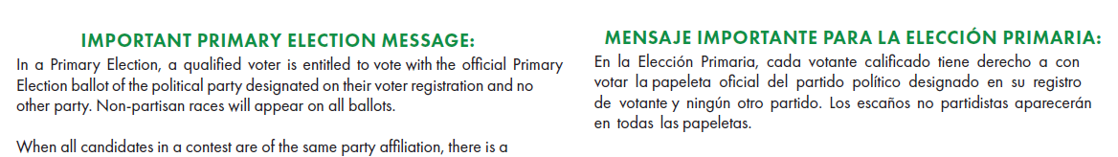
Official
Sample Ballot

Slide 9
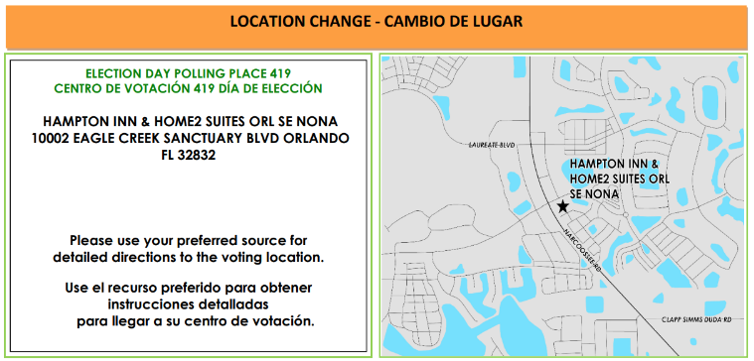
Official
Sample Ballot

Slide 10
Keep Your Record Current
Keeping your voter registration information up-to-date is important!
Name
Maiden vs. Married; Jr. vs. Sr.
UP-TO-DATE
Address
Residential address determines what you see on your ballot
Political Party Affiliation
Remember that Florida is a Closed Primary State
Signature
Signature verification at polling place and Vote-by-Mail Envelope

Slide 11
Registration Deadline
“Book Closing”
29 days before an election
  New registrations
  Party changes prior to a partisan primary
Primary Election – August 20, 2024
Book Closing – July 22, 2024 * CLOSED PRIMARY *
General Election – November 5, 2024
Book Closing – October 7, 2024

Slide 12


Slide 13

Orange County Supervisor of Elections Office
VOTE -BY-MAIL PROCESS

Slide 14


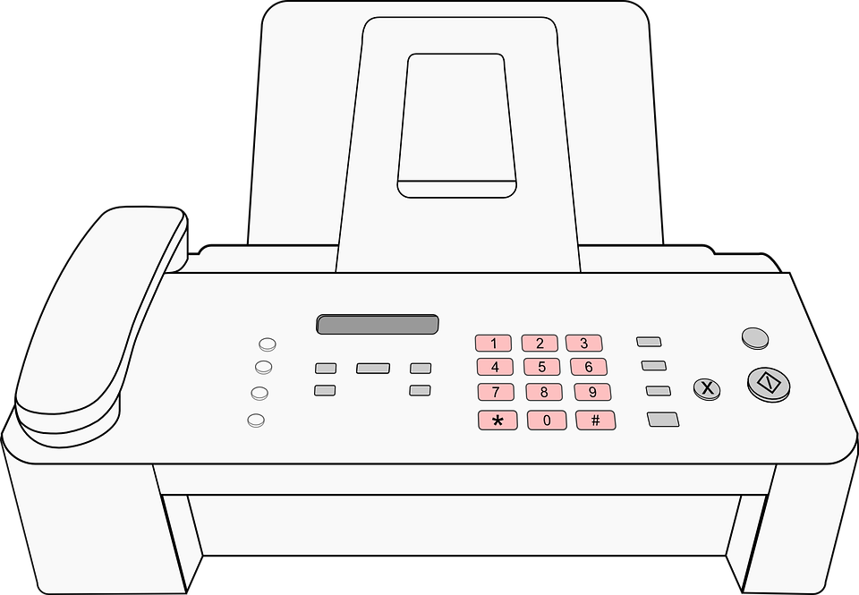
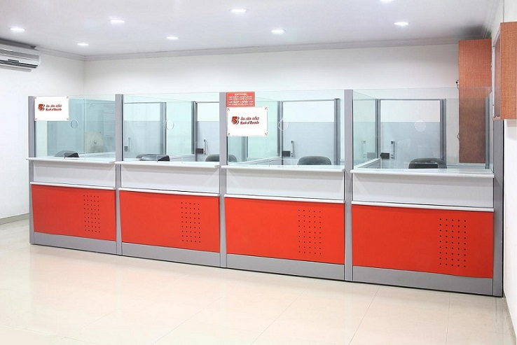


HOW TO REQUEST A VOTE-BY-MAIL BALLOT
BY PHONE
(407) 836-8683
BY MAIL
BY FAX
(407) 254-6577 / 6543
BY EMAIL
vbmrequest@ocfelections.gov
IN PERSON
119 W Kaley St
ONLINE @
WWW.ORANGECOUNTYVOTES.GOV

Slide 15
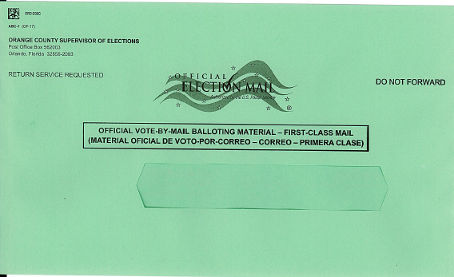
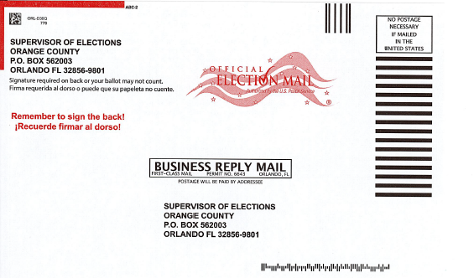
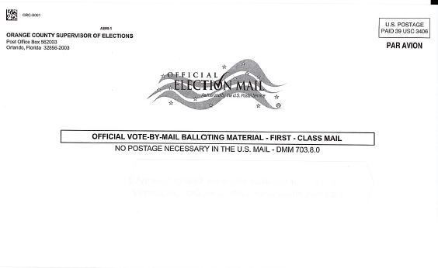
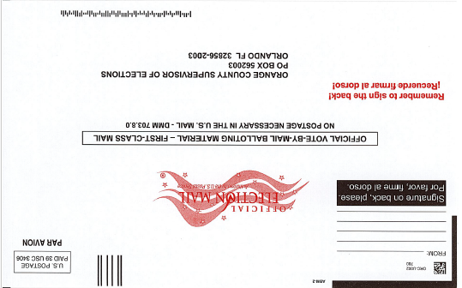
VOTE-BY-MAIL ENVELOPES
DOMESTIC
VBM ENVELOPES
UOCAVA
VBM ENVELOPES

Slide 16
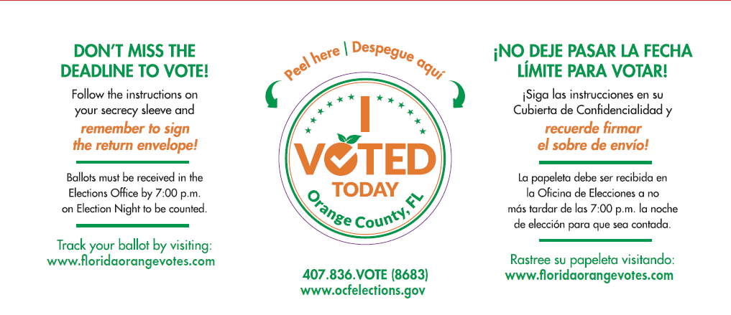
VOTE ( I DID ) STICKER

Slide 17
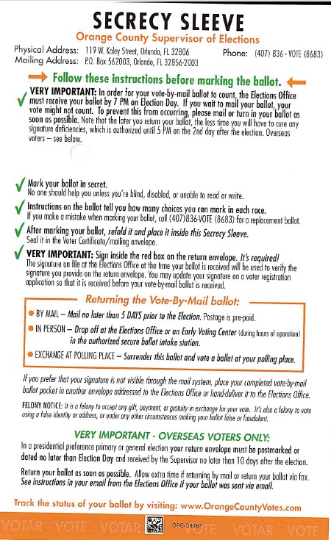
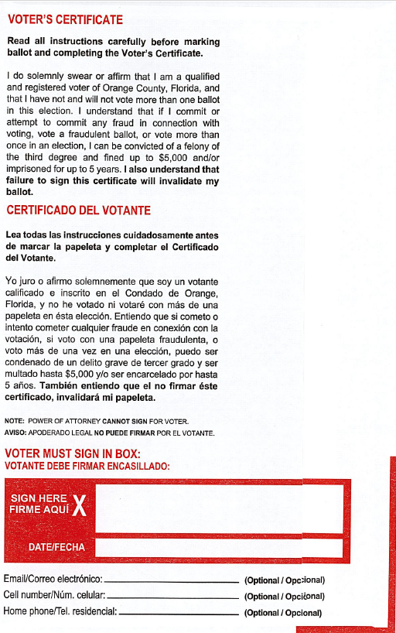
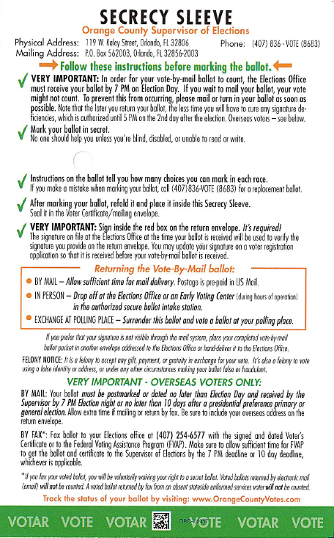
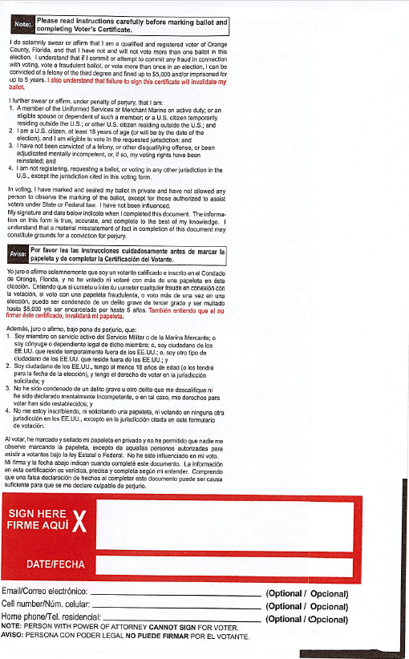
RETURNING CERTIFICATES
BALLOT

Slide 18
WHO CAN VOTE-BY-MAIL
Any registered Orange County voter
WHEN DOES A REQUEST TO VOTE-BY-MAIL EXPIRE?
A request to receive a vote-by-mail ballot covers all elections from the date a request was submitted through the end of the election cycle.
A request must then be renewed thereafter if the voter wishes to continue to receive a vote-by-mail ballot after the expiration of each election cycle.

Slide 19
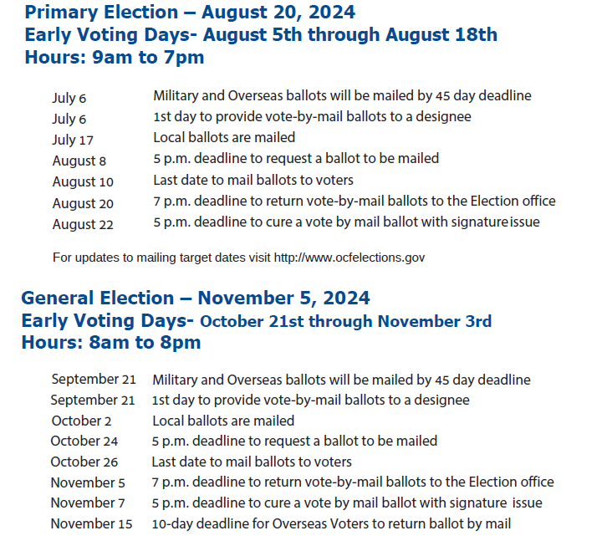
VOTE-BY-MAIL
REQUEST DEADLINE

Slide 20
Who can pick up my Vote-by-Mail Ballot?
If directly instructed by the voter, a member of the voter’s immediate family or the voter’s legal guardian.
A voter can designate any person to pick up their ballot. The designee can pick up the ballot once ballots for UOCAVA voters have been mailed.
A designee is limited to picking up vote-by-mail ballots for two other voters per election (NON-FAMILY MEMBERS)
A Designee can pick up an unlimited # of Vote-by-Mail Ballots for Immediate Family member (refers to the Designee’s Spouse, Parent, Child, Grandparent, Grandchild, or the Designee’s Spouse’s Parent, Child, Grandparent, Grandchild, or Sibling).
The Designee must submit an Affidavit to pick-up the voter’s blank ballot. Form DS-DE 162 is a combination form that includes the affidavit for ballot pick-up, the written authorization for the designee and if a request is not already on record, the voter’s request for a vote-by-mail ballot.
If a voter or designee waits until the start of mandatory early voting or up through Election Day to pick up or have delivered a vote-by-mail ballot, a special affidavit must also be completed. The voter must affirm in the affidavit that an emergency exists that keeps the voter from being able to vote at a designated early voting site in his or her county or at his or her assigned polling place on Election Day. The affidavit is part of Form DS-DE 162.

Slide 21
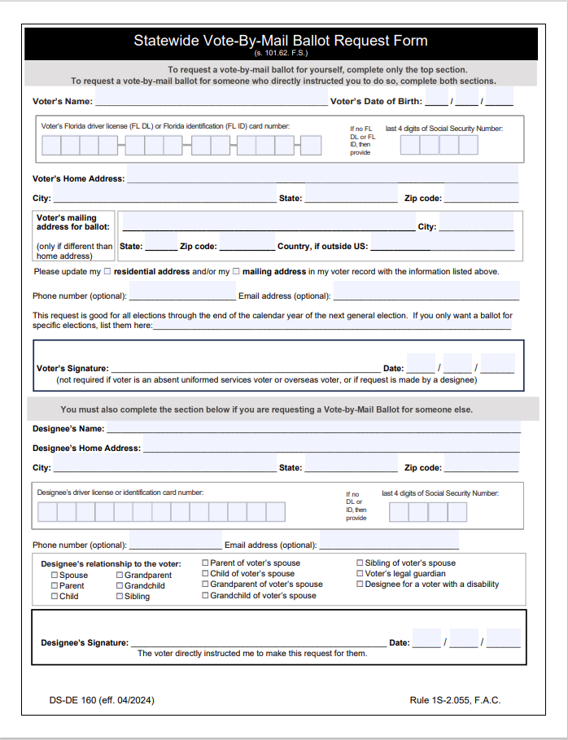
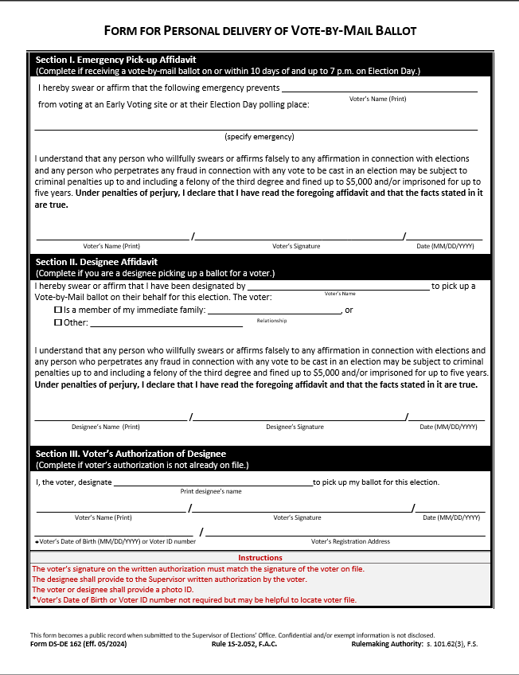

Slide 22
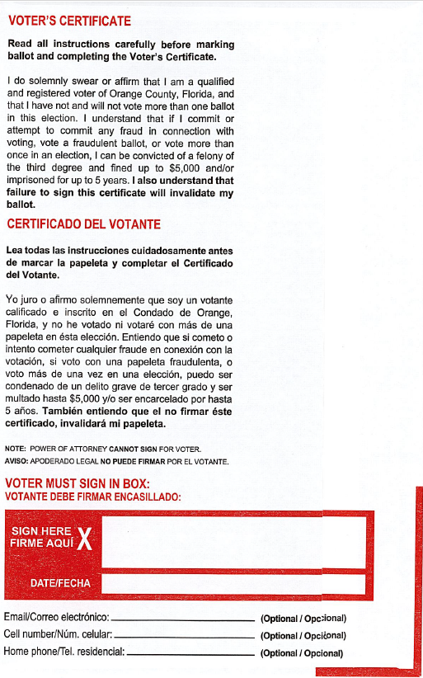



Deadline to Return your
Vote-by-Mail Ballot
Ballots must be received no later than 7 p.m. on Election Night(Postmark do not count) at the Supervisor of Elections Office
Ballots Can Not be returned to a polling place on Election Day, the Supervisor of Election Office is the only place
SIGN BALLOTS

Slide 23

PUBLIC INSPECTION OF BALLOTS / MATERIALS
F.S.101.572 Public inspection of ballots A candidate, a political party official, or a political committee official, or an authorized designee thereof, shall be granted reasonable access upon request to review or inspect ballot materials before canvassing or tabulation, including voter certificates on vote-by-mail envelopes, cure affidavits, corresponding comparison signatures, duplicate ballots, and corresponding originals.
Before the supervisor begins comparing signatures on vote-by-mail voter certificates, the supervisor must publish notice of the access to be provided under this section, which may be access to the documents or images thereof, and the method of requesting such access.
During such review, no person granted access for review may make any copy of a signature.

Slide 24

VOTE-BY-MAIL PUBLIC VIEWING
Vote-by-Mail Public Viewing Dates / Times advertised prior Election and currently available on the SOE Website, Canvassing Board Calendar.
Primary Election: August 2nd 9am - 10am
August 9th 8am - 9am
August 15th 8am – 9am
August 19th 8am – 9am
General Election: October 18th 9am – 10am
October 25th 8am – 9am
October 31st 8am – 9am
November 4th 8am – 9am

Slide 25
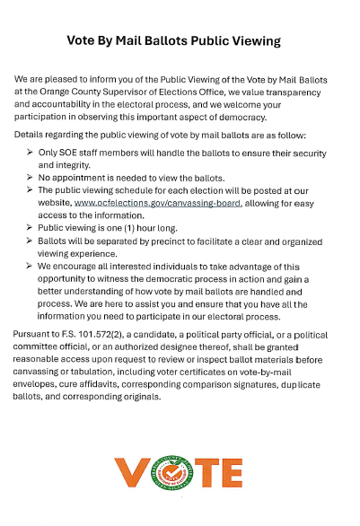

Slide 26
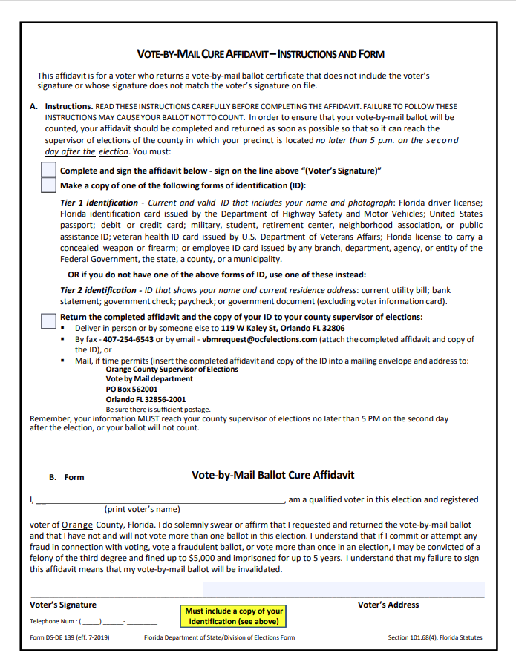
Affidavit to Correct an Un-Signed /
Signature Difference Certificate
Every Unsigned and Signature Difference Status receives a Cure Affidavit via Mail. If voter provided email / phone, we’ll contact them as well via these methods.
The Election Office will mail voters a letter with the Affidavit to correct this issue.
The voter must return the completed affidavit with a copy of an ID or required documentation
Voters have until 5pm the 2nd day after the Election to correct a signature issue.
Primary 08/22
General 11/07
Voters may also check the status of their ballot and download a copy of the affidavit on our website: www.ocfelections.gov under the Vote by Mail menu.
Candidates can see who has been sent a CURE Affidavit.

Slide 27
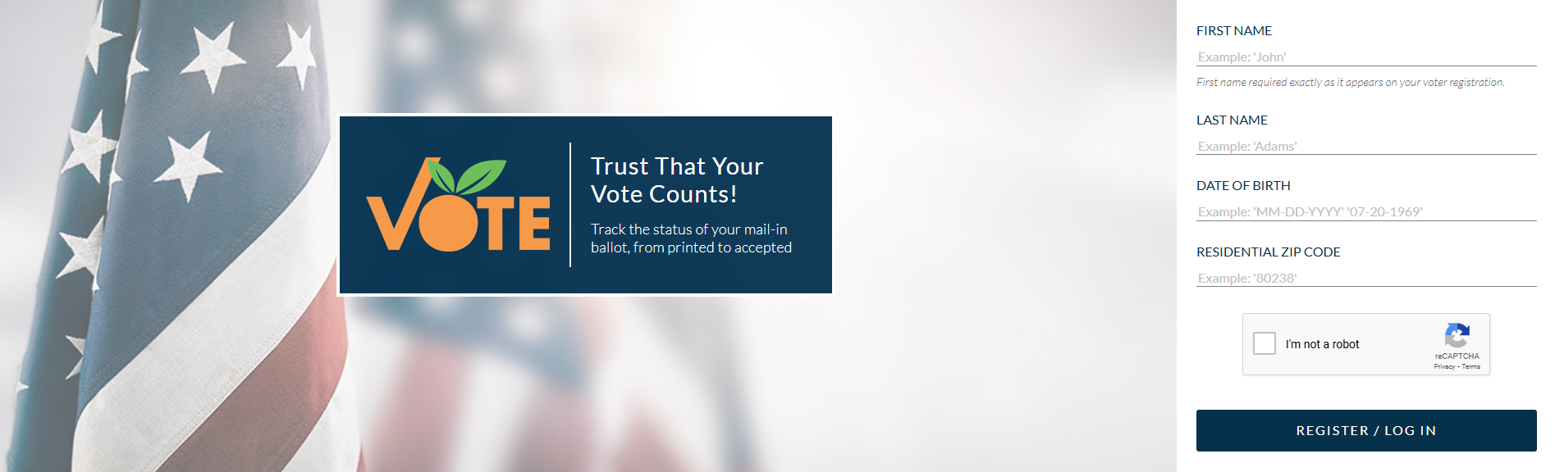
Track your Ballot Status
Voters can find out when their ballots were mailed and view the status of their ballot by visiting our Ballot Track System.
www.FloridaOrangeVotes.com

Slide 29

2024 Early Voting Changes
New Site - Lift Orlando (Pine Hills Area) Primary and General
New Site - Town of Eatonville Town Hall
Total of 22 sites
2024 Early Voting Dates and Time
Primary Election - August 5, 2024 through August 18, 2024 from 9am to 7pm
General Election – October 21, 2024 through November 3, 2024 from 8am to 8pm
Over-Flow Parking Sites
Southwest Library (YMCA)
Alafaya Library
Winter Garden Library

Slide 30
22 EARLY VOTING CENTERS
Alafaya Library 12000 E. Colonial Dr. Orlando, 32826 | Apopka Community Center 519 S. Central Ave. Apopka, 32703 | Chickasaw Library 870 N. Chickasaw Trail. Orlando, 32825
Fairview Shores Library 902 Lee Road, Suite 26, Orlando, 32810 | Hiawassee Library 7391 W. Colonial Dr. Orlando, 32818 | Lift Orlando 710 S. Tampa Ave. Orlando, 32805
Marks Street Senior Recreation Complex 99 E. Marks St. Orlando, 32803 | Meadow Woods Recreation Center 1751 Rhode Island Woods Cir. Orlando, 32824 | Supervisor of Elections 119 W. Kaley St. Orlando, 32806
Orange County National Golf Center 16301 Phil Ritson Way, Winter Garden, 34787 | Renaissance Senior Center 3800 S. Econlockhatchee Trail, Orlando, 32829 | South Creek Library 1702 Deerfield Blvd. Orlando, 32837
Southeast Library 5575 S. Semoran Blvd. Orlando, 32822 | Southwest Library 7255 Della Dr. Orlando, 32819 | Town of Eatonville Town Hall 307 E. Kennedy Blvd. Eatonville, FL 32751
Tibet- Butler Preserve 8777 County Road 535. Orlando, 32836 | UCF- The Garden Room at Live Oak 4115 Pyxis Lane. Orlando, 32816 | Valencia College-Lake Nona Campus 12350 Narcoossee Rd. Orlando, 32832
Washington Park Library 5151 Raleigh St, Suite A, Orlando, 32811 | West Oaks Library 1821 E. Silver Star Rd. Ocoee, 34761 | Winter Garden Library 805 E. Plant St. Winter Garden, 34787
Winter Park Library 1052 W. Morse Blvd, Winter Park, 32789 | Vote-by-Mail Drop Off available at each location. | For more information contact (407) 823-2070 Ext: 71185

Slide 31
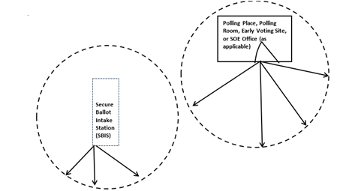
Secure Ballot Intake Stations (Vote-by-Mail Drop Off)
Drive through locations convenient for voters.
Ballots can be dropped off during Early Voting Hours at any of the 22 Early Voting Sites.
Ballots securely transported to SOE at the end of each day.
There’s a 150 feet no solicitation zone from the Intake Station.
Not all stations are located by the entrance (150 further out)
Solicitation Zone F.S. 102.031 (4) (a)
Before the opening of the early voting site, the Early Voting Deputy designates the no-solicitation zone and marks the boundaries.
Any campaigning signs found inside the 150 feet no-solicitation zone, will be removed and placed outside the zone by the Deputy.
Some sites do not allow solicitation on their property, designating an off-property area for campaigning.
Media is only allowed within the 150 feet no-solicitation zone, if conducting Exit Poll Interviews.

Slide 32
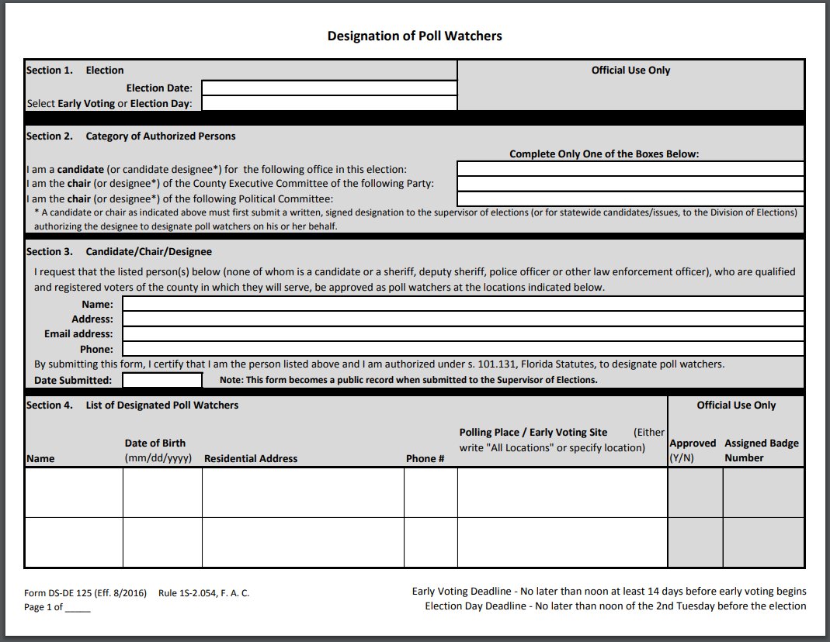
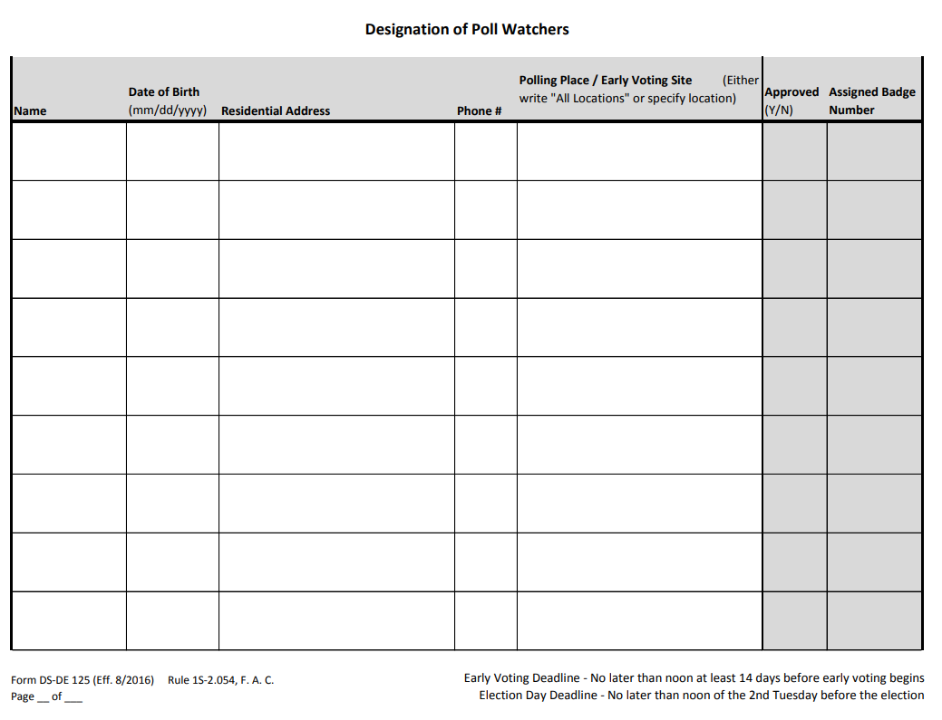
Poll Watchers
Designation of Poll Watchers shall be submitted in writing to the Supervisor of Elections using the Designation of Poll Watchers form (DS-DE 125), located on the SOE website ocfelections.gov under Candidates, Candidate Resources.
Form must be submitted ONLY by a Candidate or Political Party two weeks prior Early Voting and two weeks prior Election Day by NOON for each Election.
Primary Election
July 22, 2024 EV & August 6, 2024 ED
General Election
October 07, 2024 EV & October 22, 2024 ED
Poll Watchers must wear a badge (provided by SOE) and represent one Candidate or Party at a time.
Cannot interfere with the voting process, touch equipment or interact with voters. Questions should be directed to the site Clerk.

Slide 34
Florida Department of Transportation
Outdoor Advertising

Slide 35

WHAT IS THE RIGHT OF WAY AND HOW DO I KNOW WHERE IT IS?
The right of way for a road or other transportation facility is the paved area of the road, the road shoulders, sidewalks, swales, and all the other property adjacent to the road owned by the government for the construction and operation of the road or other facility. It may extend far beyond the paved road surface and may or may not be mowed or fenced.

Slide 36
Unauthorized use of the public right of way is prohibited by Florida law.
Illegal use of the right of way is a crime. Each day a violation continues is a separate offense.
Section 337.406, Florida Statutes

Slide 37
Red Arrow = Bad
Green Arrow indicates = Good

Slide 38
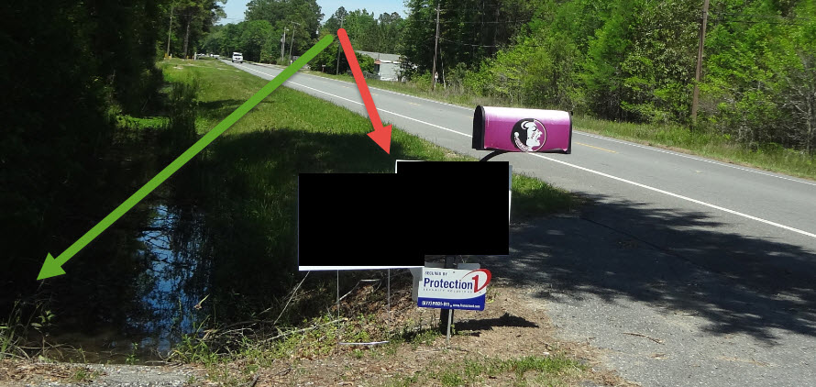

Slide 39
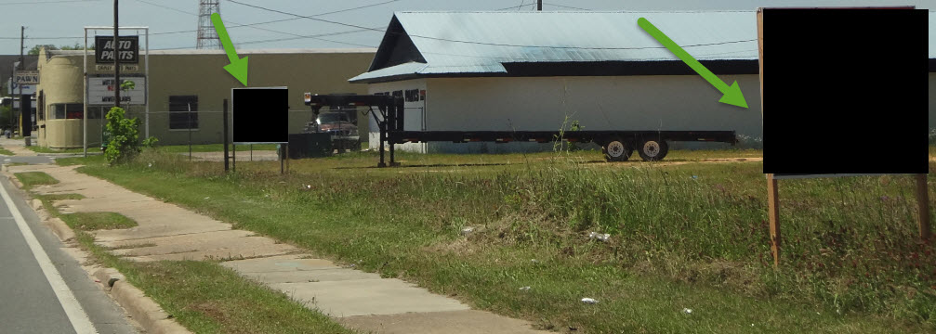

Slide 40
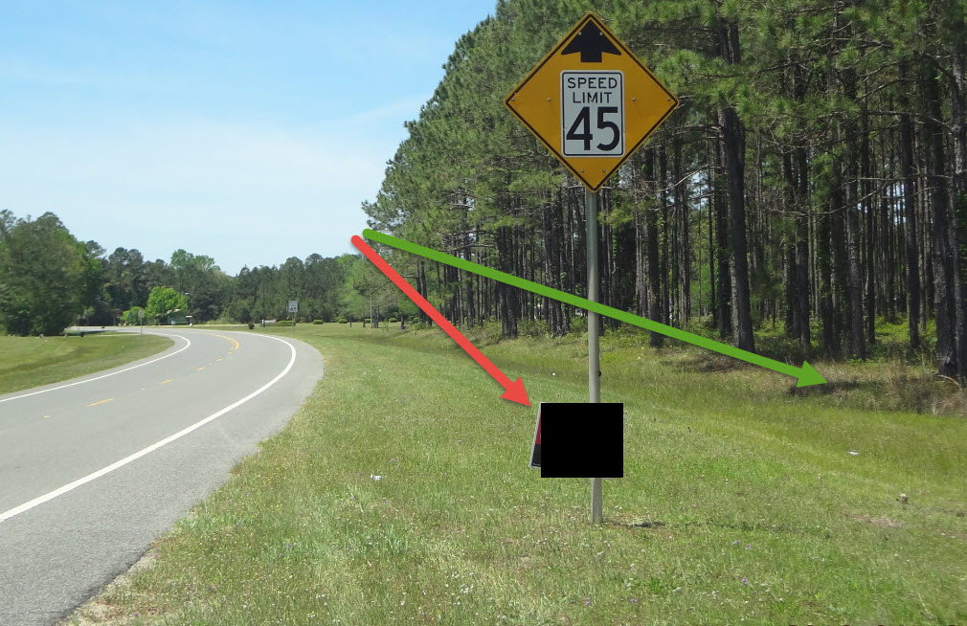

Slide 41
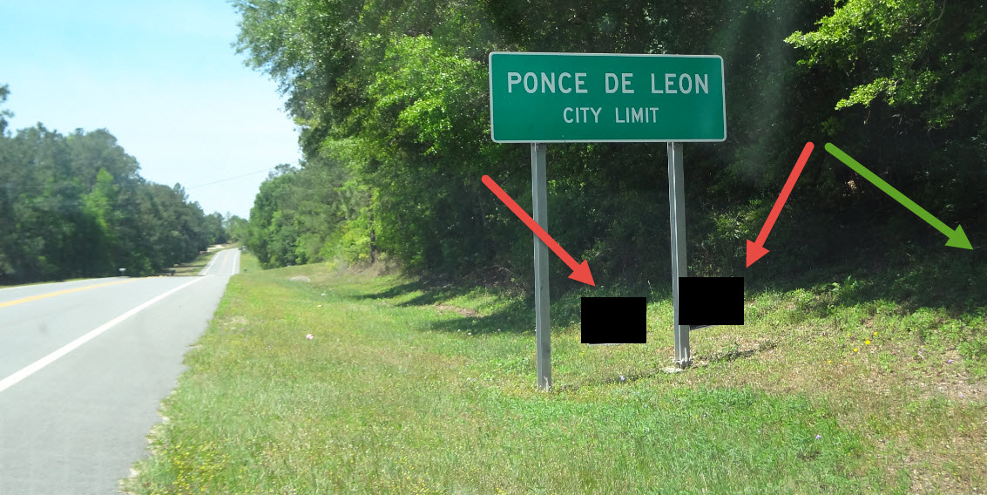

Slide 42
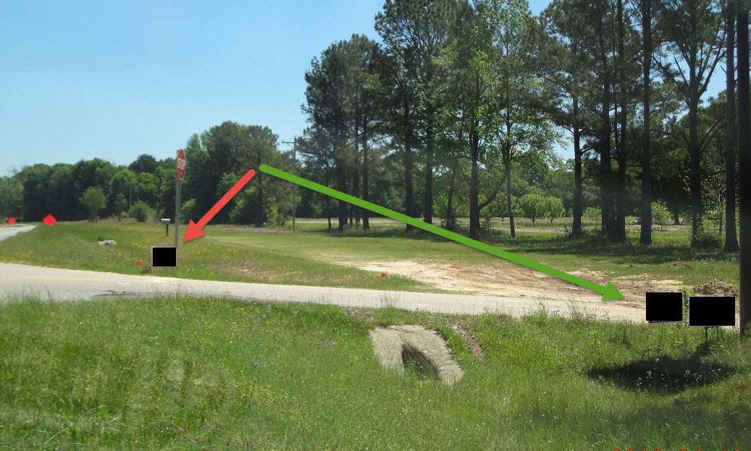

Slide 43
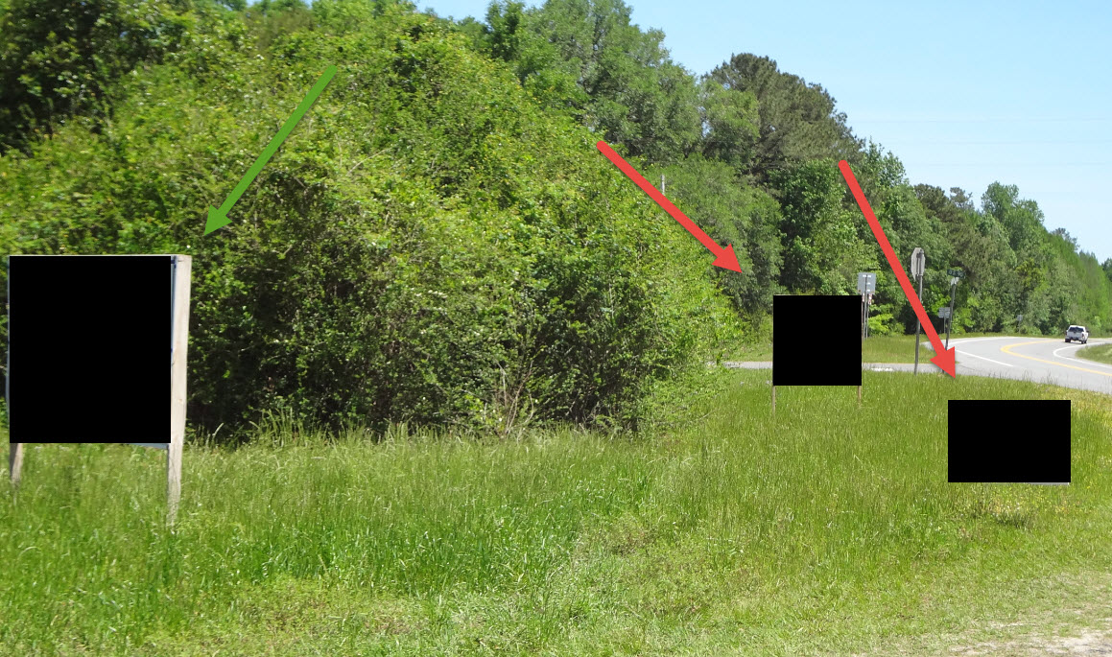

Slide 44
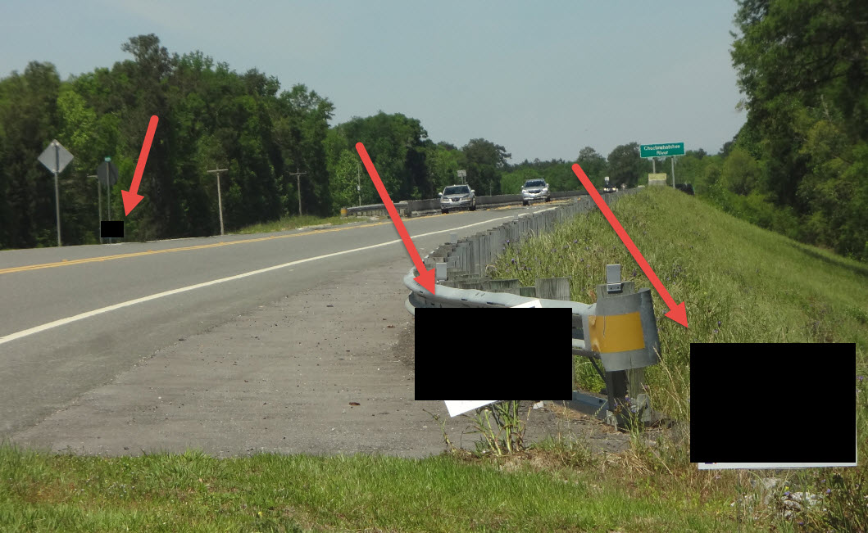

Slide 45
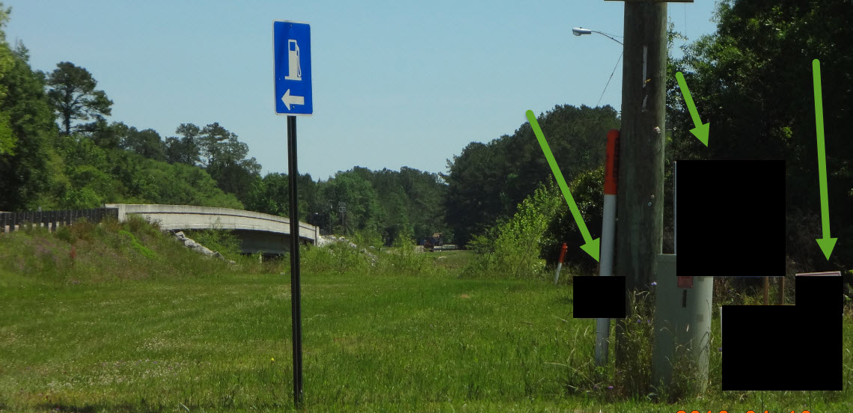

Slide 46
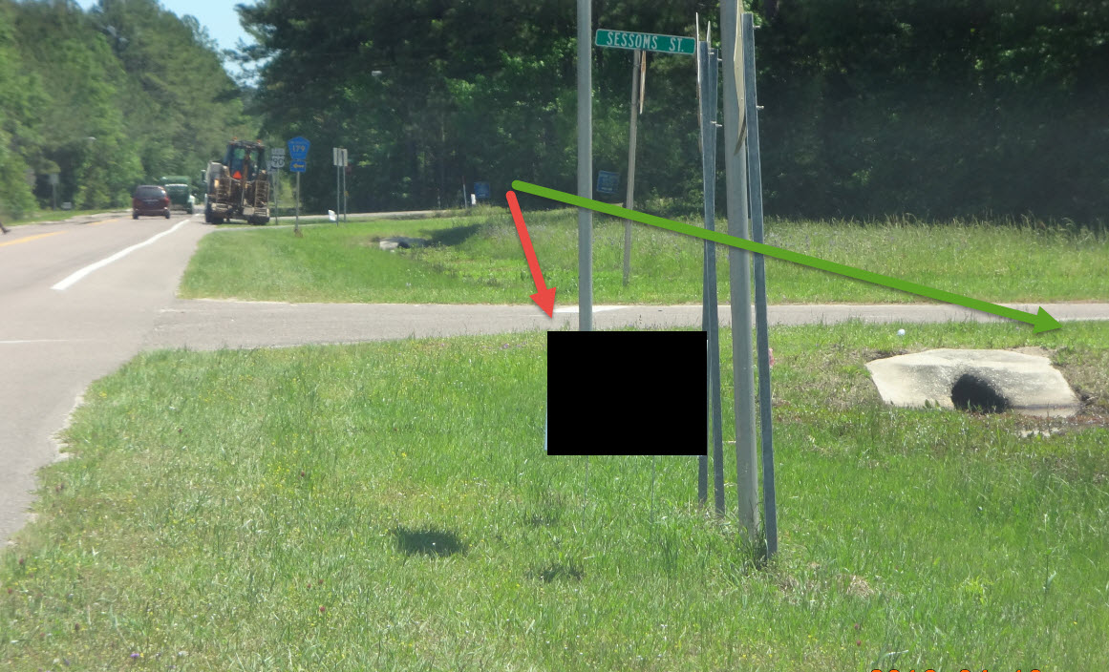

Slide 47
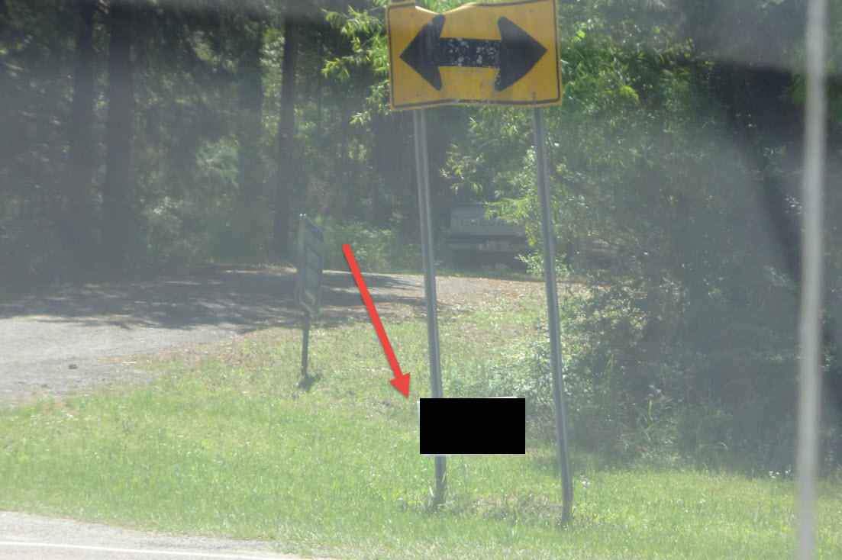

Slide 48
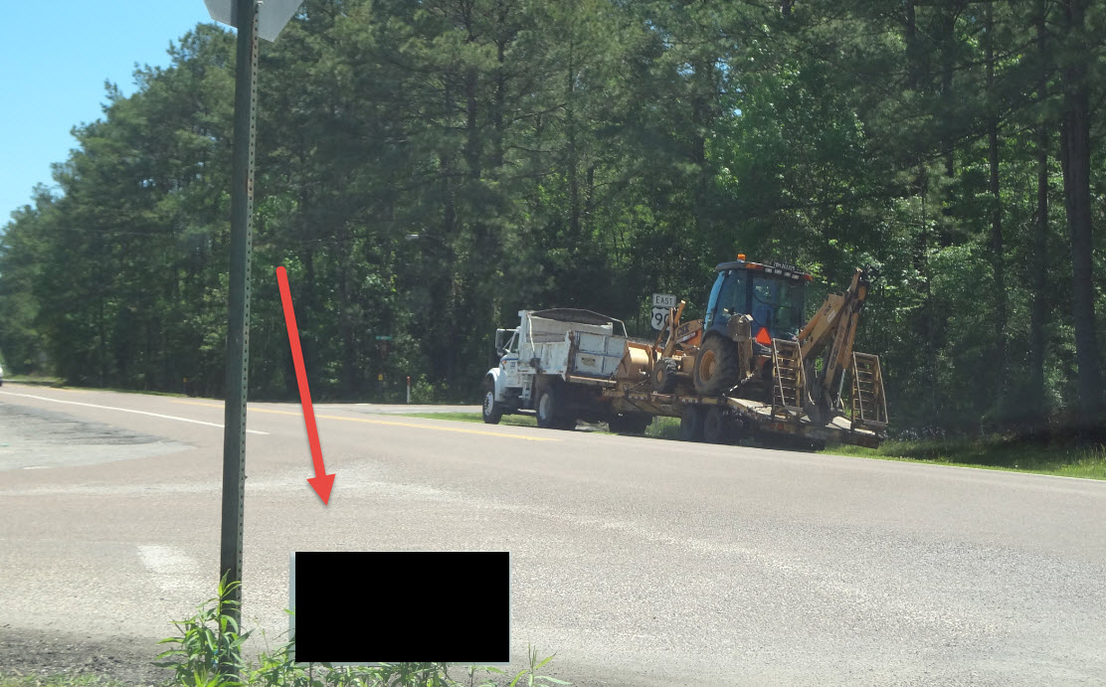

Slide 49
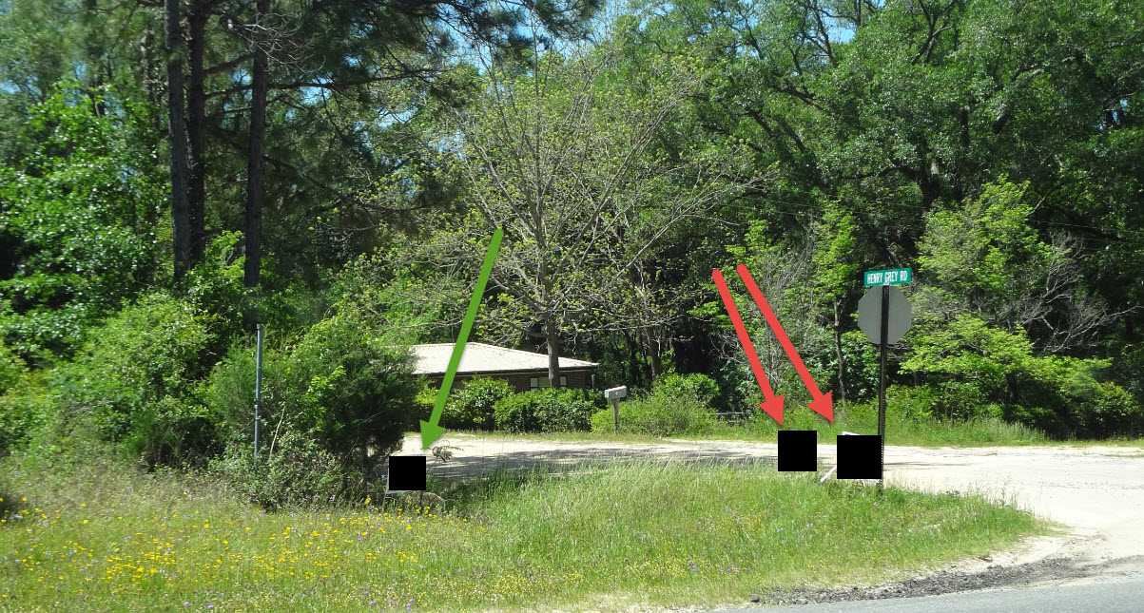

Slide 50
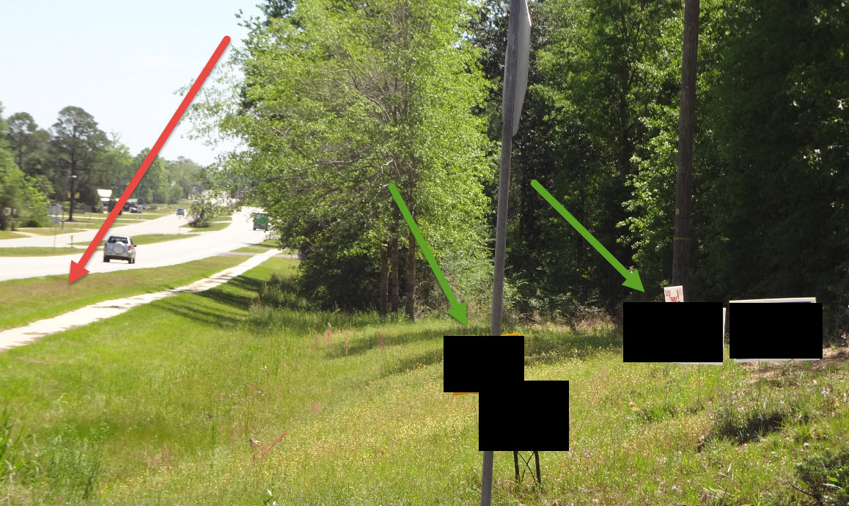

Slide 51
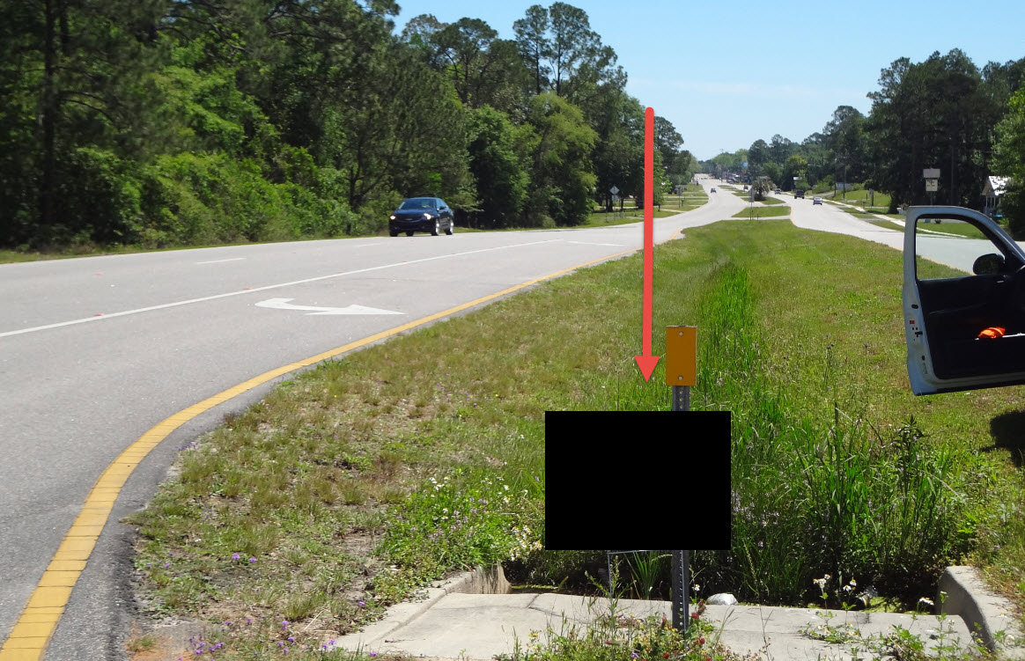

Slide 52
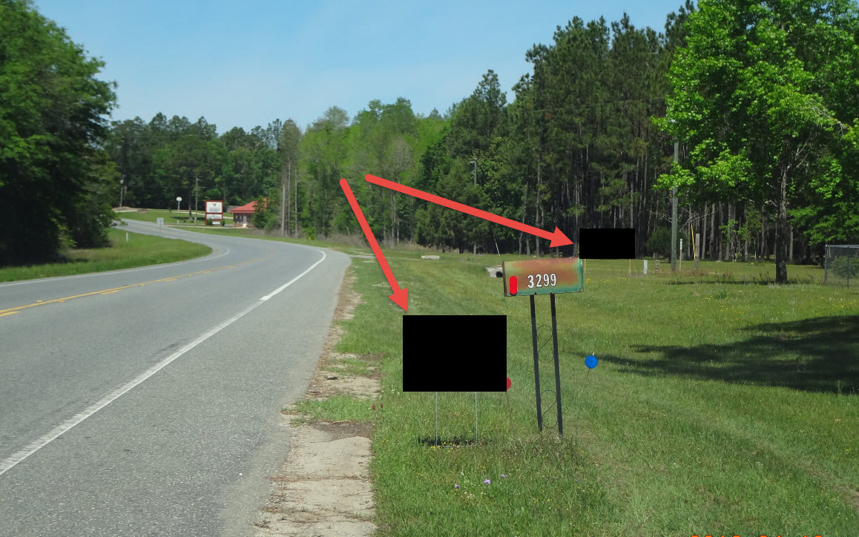

Slide 53
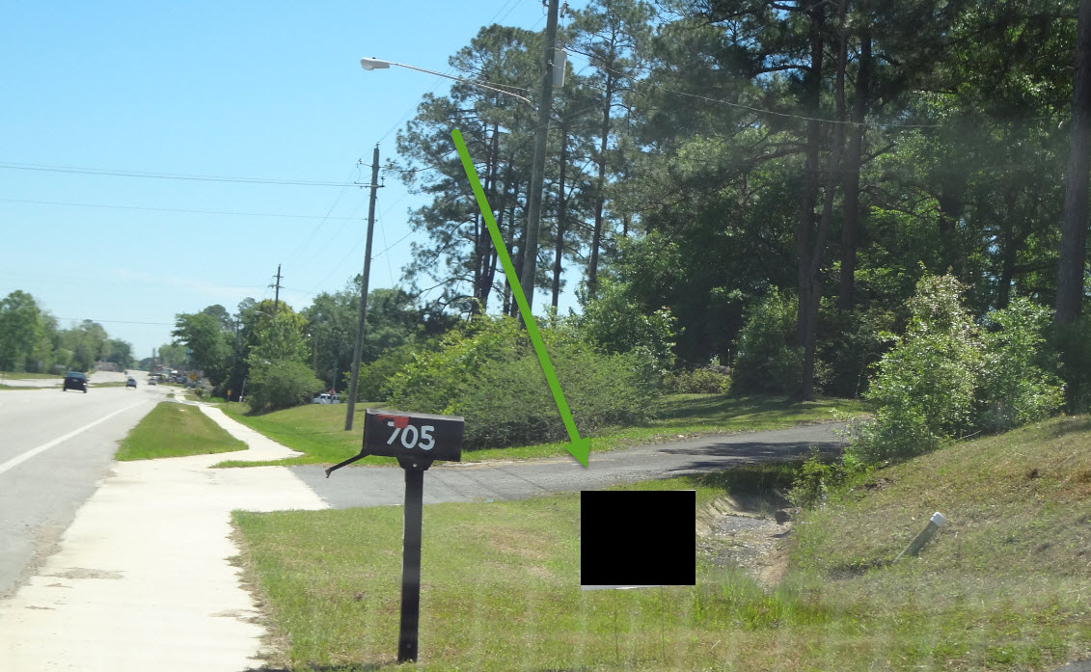

Slide 54
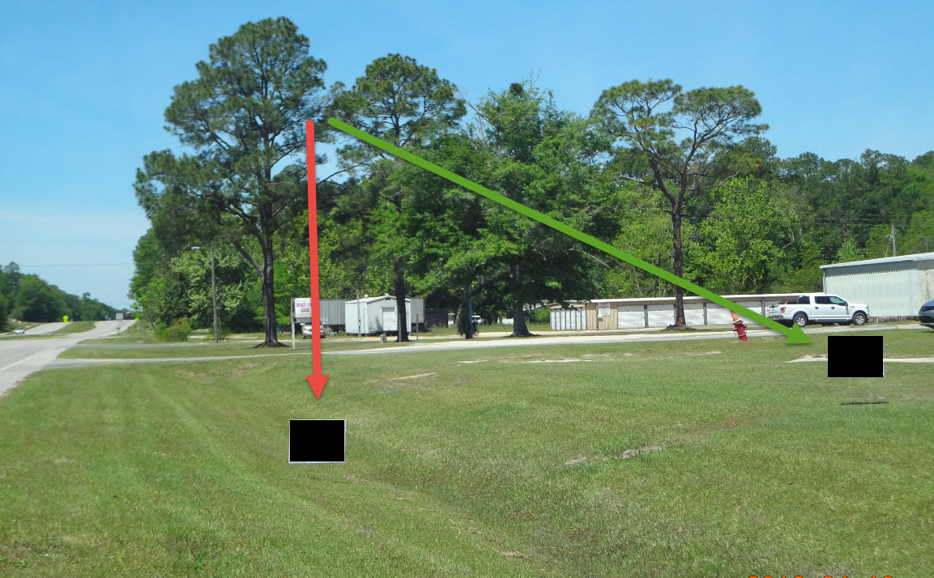

Slide 55
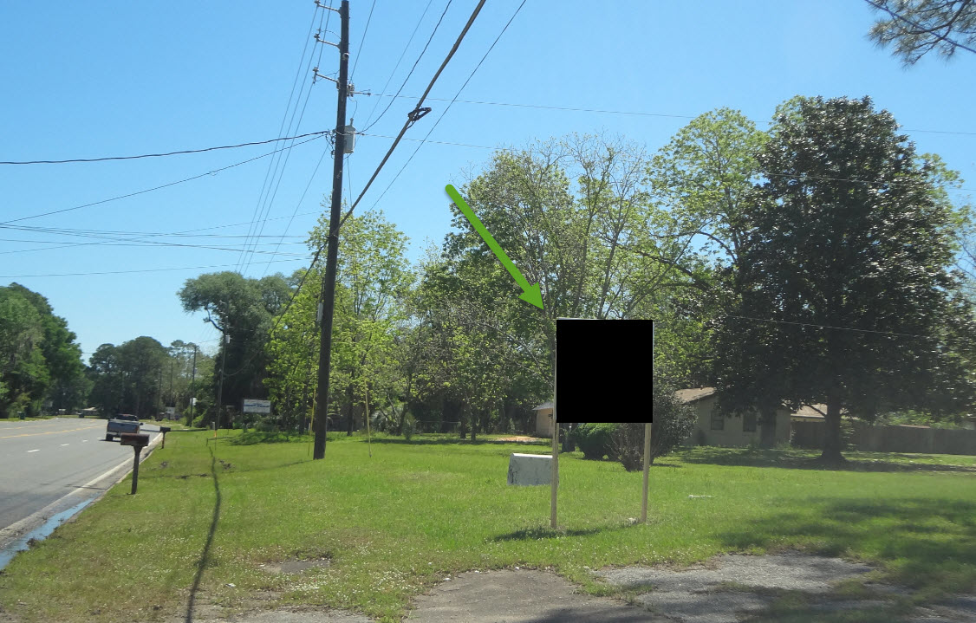

Slide 56
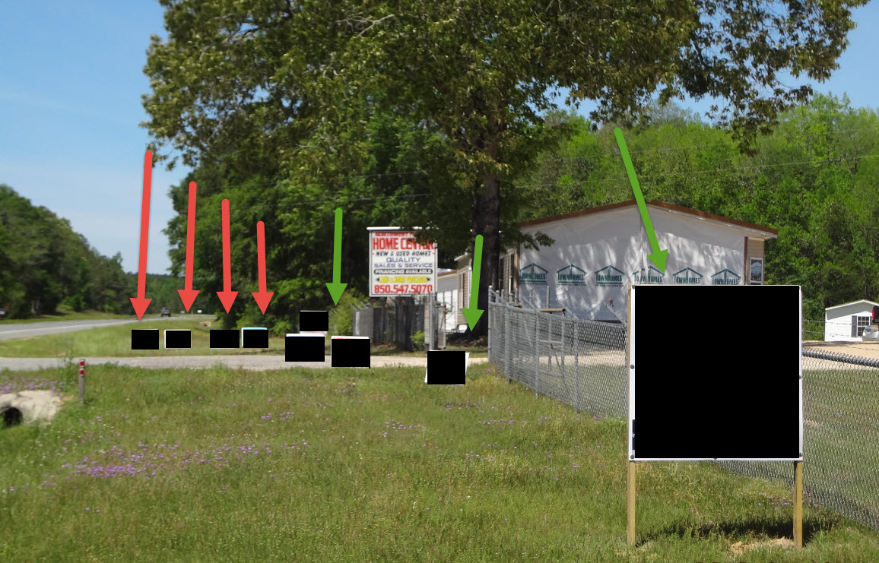

Slide 57
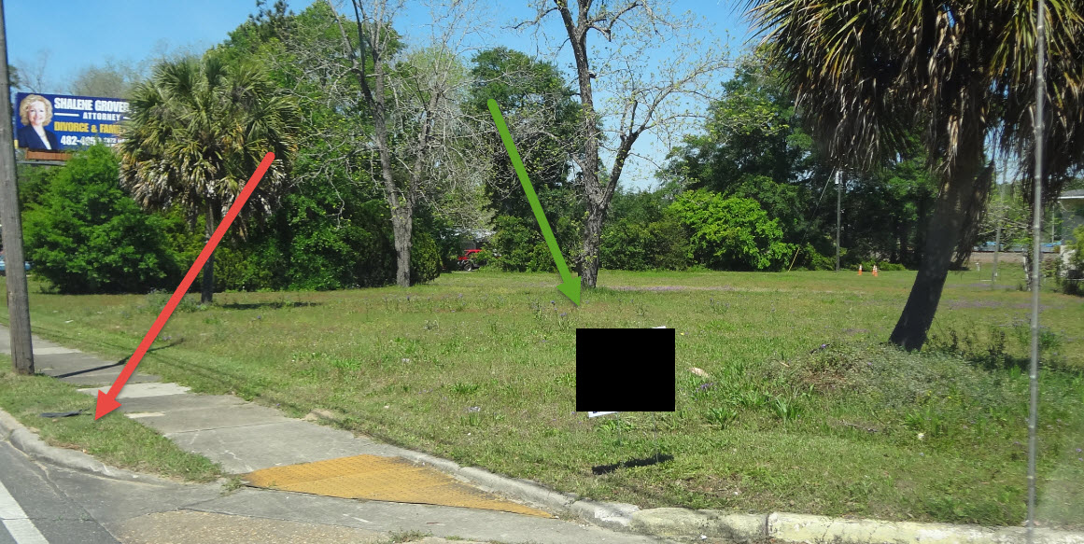

Slide 58
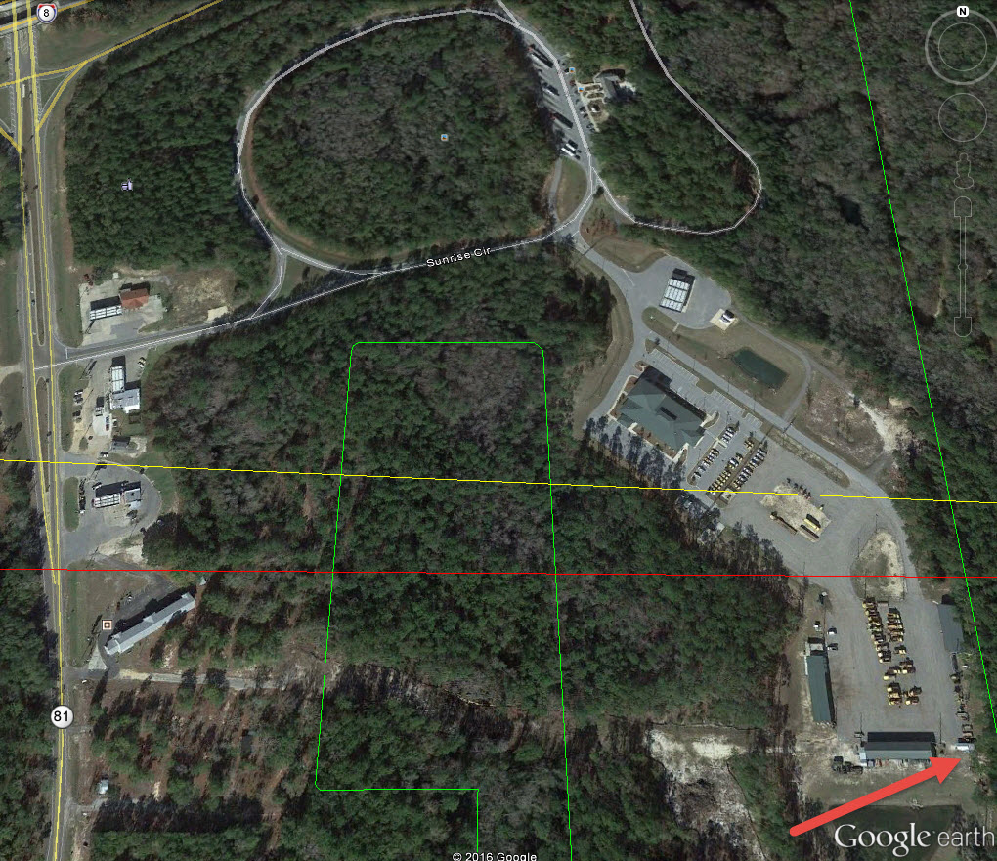

Slide 59
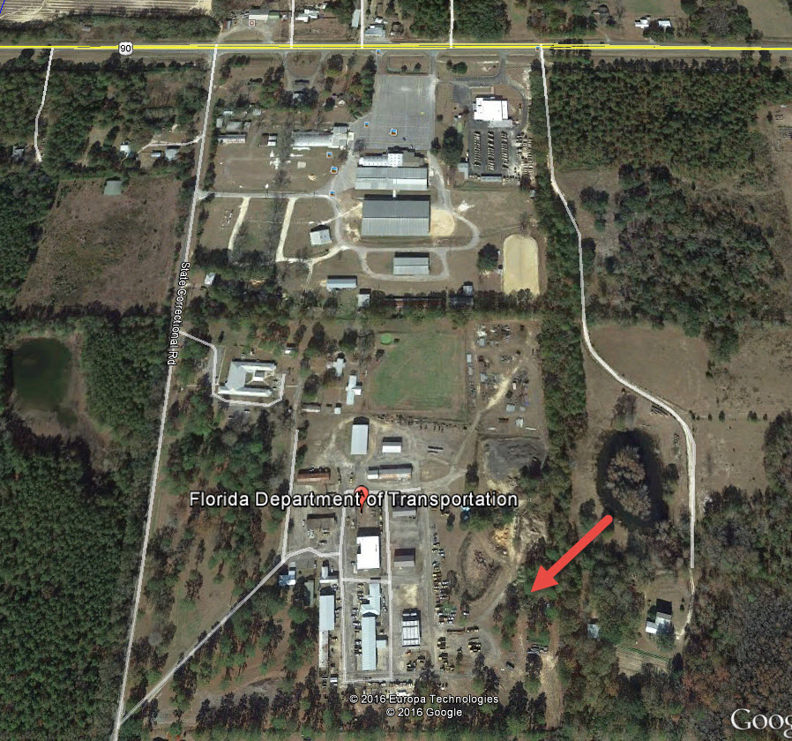

Slide 60

Officer Glenn Bynes
Code Enforcement
City of Orlando
City of Orlando Sign Information

Slide 61

Amy D. Envall, General Counsel,
Office of Legal Services, Orange County Public Schools

Slide 62

Election Issues and Campaigning on OCPS Property
June 21, 2024
Supervisor of Elections’
Candidate Forum

Slide 63
Election Issues and Campaigning on OCPS Property
Many times, the mistakes that candidates and their volunteers make when it comes to campaigning on OCPS property are because they simply were not aware of our School Board policies or they may simply be misinformed or misguided.
This presentation covers 10 of the most frequently asked questions (FAQs) and accompanies the memorandum, which is prepared in a simple Question and Answer (Q&A) format to help address common issues that come up during the election season.
Our goal is to educate candidates and elected officials on the application of the relevant provisions of law and our School Board policies.

Slide 64
Flyers, Pens, Campaign Business Cards, Bumper Stickers, Other Swag, and Other Campaign Materials at a School Event:
An OCPS school hosts an “after hours” community event such as a strings concert, a school-sponsored play, a PTA meeting, or a community meeting. Can a candidate for office hand out flyers, pens, campaign business cards, bumper stickers, campaign swag, or any other campaign materials to those in attendance at the “after hours” community event held at the school?
No.
(See detailed discussion to Question 1 in memorandum.)

Slide 65
Use of OCPS Emails to Further Campaign
I am a candidate and I have obtained a list of all OCPS employees’ emails (they are all public record). I am going to send them all an email to their OCPS accounts suggesting that they vote for a particular candidate or otherwise participate in a campaign event. Is this email consistent with OCPS policy? Can I also suggest that the OCPS employees forward my email to others?
No and no.
(See detailed discussion to Question 3 in memorandum.)
***As a proactive measure, OCPS offers the ability to block certain email accounts from being able to send OCPS employees campaign-related emails. Please contact Amy Envall, General Counsel, at 407-317-3411 or amy.envall@ocps.net with a request to block your campaign-related email address.

Slide 66
Current Elected Official Address to a Class, Assembly, or Group of Parents at a School
A current elected official, up for reelection, would like to address a class, an assembly, or a group of parents/legal guardians at an OCPS school to update them on a particular legislative issue or subject. Is this permissible?
Yes.
  Example: If a parent/candidate is an engineer or an accountant and he/she speaks to a class about his/her duties in his/her professional capacity as an engineer or an accountant, that is permissible; but, if a parent/candidate is asked to address staff about his/her campaign, that would not be permissible. Finally, do note that, as with any other speaker, no distribution of campaign literature is permitted before, during, or after the presentation.
(See detailed discussion to Question 4 in memorandum.)

Slide 67
Meeting with Principals
As a candidate for office (school board or any other position), I wish to contact a principal to discuss general issues in schools. Can I do so? Is the principal required to meet with me? Can I tour the school?
Yes, no, and yes.
(See detailed discussion to Question 6 in memorandum.)

Slide 68
Seeking Endorsements
As a candidate for office (school board or any other position), or a currently elected official, I wish to contact OCPS employees to seek their endorsement. Can I do so on Board Property?
No.
(See detailed discussion to Question 7 in memorandum.)

Slide 69
Private Charitable Fundraisers Held on OCPS Property
A charitable fundraiser for a foundation or booster club that will benefit an OCPS school has been scheduled at a school or facility pursuant to an OCPS Facility Use Agreement by an outside user. Can campaign signs be present at that event on OCPS property since the event is not a school-sponsored event and since OCPS is leasing the facilities to a third party?
No.
(See detailed discussion to Question 8 in memorandum.)

Slide 70
Starting a Rally or Petition Drive at an OCPS School or OCPS Parking Lot
A candidate has advertised a rally and a possible petition drive on a weekend morning or during the summer when classes are not in session. The starting location for the rally has been advertised as an OCPS school or facility or OCPS parking lot. Is this permissible?
No.
(See detailed discussion to Question 12 in memorandum.)

Slide 71
School Awareness Event at a School to Honor
Certain Political Candidates
I would like to schedule a school awareness event at an OCPS school, such as a breakfast, to honor certain political candidates and invite members of my community. Must I invite all candidates running for office for that position?
Yes.
Board Policy KF – Public Use of School Board Facilities does allow for such events so long as the following guidelines are strictly adhered to:
    Sponsorship is by an organization having an official affiliation with the school or school district (such as a PTA, SAC, or a Foundation).
    An invitation, in writing, is extended to all announced candidates for the specific office. If qualifying has not yet occurred, consult the Supervisor of Elections’ website to determine which individuals have filed paperwork and intend to run.
    The time allotted for presentations is the same for each candidate and no preferential treatment is afforded to any candidate in any way.
Do note that, in this limited forum, campaign materials MAY be distributed at these events but SHALL be confined to the immediate area in which the forum is being conducted. The decision to provide materials is discretionary on the part of the event organizers and is not required.

Slide 72
Election Day Restrictions on Political Activity on OCPS Property
An OCPS school has been selected as a polling place. Do the restrictions on political activity in Board Policy KF – Public Use of School Board Facilities apply on Election Day?
No.
(See detailed discussion to Question 14 in memorandum.)

Slide 73
Active or Passive Distribution of Political Materials on OCPS Property on Election Day
An OCPS school has been selected as a polling place. Do the active or passive distribution of political materials apply pursuant to Board Policy KHC – Distribution/Posting of Promotional Materials on Election Day?
No. The selection of an OCPS school or facility as a polling place also requires that a safe election zone be established no closer than 150 feet to the entrance of the polling place under Section 102.031, Florida Statutes. Typically, this area is well marked by the Supervisor of Elections’ Office and any solicitation or petition gathering or handing of political materials is restricted to the area identified by the Supervisor of Elections’ Office.

Slide 74
Bonus: OCPS Employees Wearing
Campaign T-Shirts on OCPS Property
Can an OCPS employee proudly support a candidate or issue of his/her choice by wearing a campaign t-shirt?
Yes, but only if the OCPS employee is NOT wearing such campaign clothing during the school day or while the employee is officially “on the clock” on behalf of OCPS. Pursuant to Board Policy GBI – Political Activities of Staff, OCPS employees may not “engage in passive political expressions, including but not limited to wearing a lapel pin, campaign button, hat, or political advertising on items of clothing.” However, after hours expressions are permissive. Similarly, Board Policy GBI prohibits the display of “any political advertising or signage on OCPS owned vehicles.”

Slide 75
Questions
Should you have any further questions regarding any of these issues or any other election matters as they pertain to OCPS property, please do not hesitate to contact me directly at (407) 317-3411 or email me at amy.envall@ocps.net.
*Please indicate if the matter is time sensitive as is usually the case with elections issues.

Slide 77

Election Day: Polling Places and Libraries

Slide 78
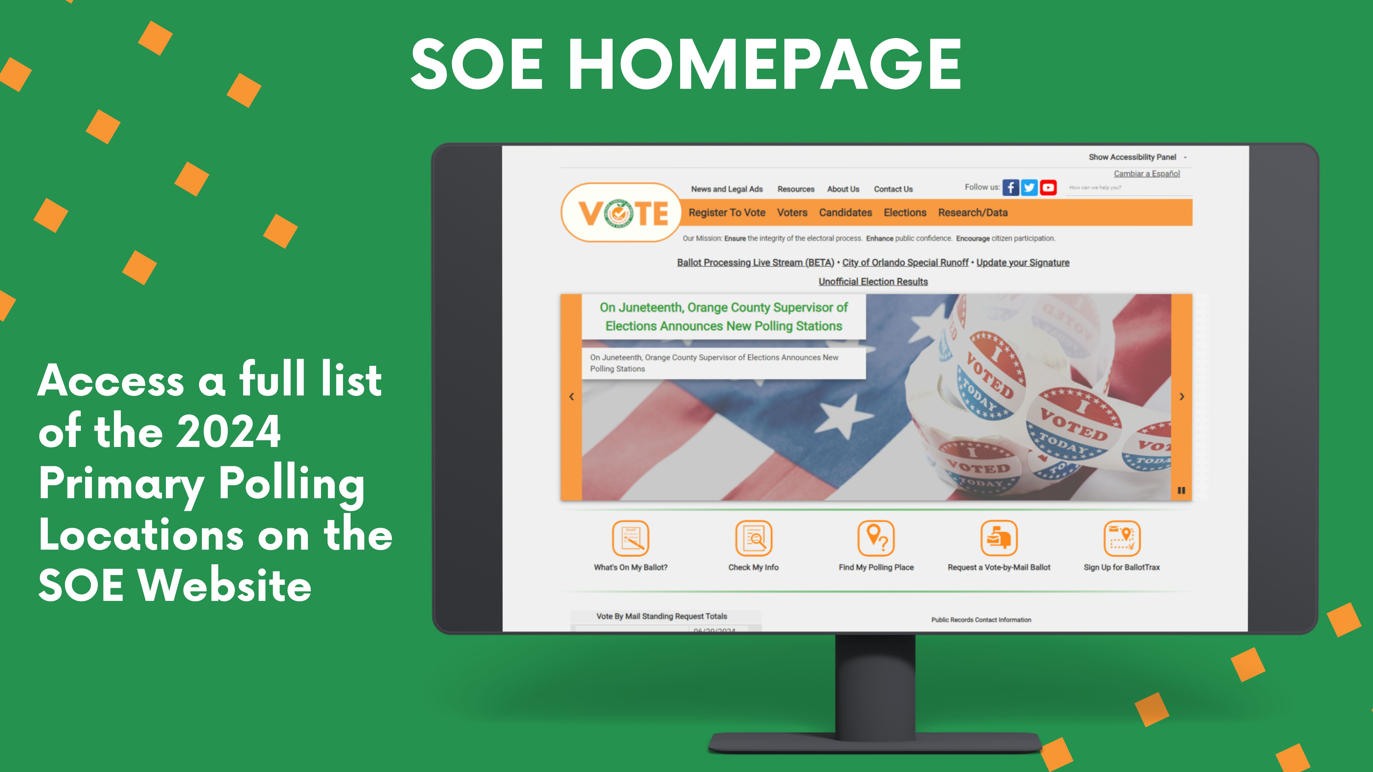


Slide 79
Understanding
Precinct
Sub-Precinct
Municipal Suffix Structure
Redistricting
2024 Redistricting
Mapping
Products Available
Orange County SOE:
Mapping Products

Slide 80

First Three Digits: 201XXX – County Precinct with a singular polling place​
(First digit is County Commission District – EXCEPT 9)​
*900 series Precincts created to accommodate U.S. Congressional Plan P000C0109​
​
Fourth Character: XXXS/A/B/C/D/EXX- Precinct Split for County Level Districts​
​
Two Digit Suffix: XXXX00 – Municipal Precinct​
Precinct Structure Example: 201xxxx

Slide 81








Slide 82


FLORIDA HOUSE DISTRICT 45
SCHOOL BOARD 7
FLORIDA HOUSE DISTRICT 41
SCHOOL BOARD 4

Slide 83

Municipal
Code Key

Slide 84



Slide 85


904 Renamed to 114
117 & 119
extended to take portions of 124
Orange County Redistricting 2024

Slide 86


Orange County Redistricting 2024
242 created from 223
417/418/419
created from 405/416

Slide 87



All maps on our website are free to download !!
Print outs - Public Records Desk- Sizes include
11x17 ($1), 24x36 ($5), 36x48 ($10),
Special request (custom maps = $ per hr. of work).

Slide 89

Reports & Records Requests
Records Department

Slide 90
Public Records Request Policy
Our office has a public records request policy which we share in response to any records requests submitted to our office; the policy will cover most of your questions related to records requests. The policy will help you understand the scope of the public records request and what to expect regarding the format, nature, time, and the requested records' cost. We include a copy of our policy and form in the packet for your reference.
Request Fulfillment – The Public Records Act "demands prompt attention and a reasonable response time," not the quickest-possible response. (3) Requests may take up to 9 business days during a non-election cycle and 15 business days during an election cycle, which is subject to change depending on the extent of the request. We will assess the large requests individually and notify the requester if the request exceeds the estimated preparation time. F.S. 119.07. (1)(c).

Slide 91

Reports
Candidates are eligible to request and receive the following:
Data access account.
Vote by mail requests information.
Early voting information.
Voters' list with and without voting history. “without history AKA; Walking List “, “Voters’ list with history AKA; Super Voters List “.

Slide 92


DATA ACCESS ACCOUNT APPLICATION

Slide 93
Data Access Account
The candidate data access account contains the following records:
a) Vote by Mail request list, and reports are "Confidential per section 101.62(3), Florida Statutes.
b) Early voting reports.
c) Voters' list (with & without history). "Current System Available history 2004 to present.“ “Prior years will take longer to produce”.
e) Any files subject to the public records request scope which can't be shared by email.
Accounts Requirements:
1. Complete an application.
2. Username and password are provided only for candidates via phone or face to face.
Account Files Availability:
1.VBM files will be available 60 days before the election and 15 days after the election certification date. 101.62(3), Florida Statutes
2.Upon request Files will be posted to the account for 14 days.
3. Files are posted in zip folders (PDF & text format). Files are provided in the format maintained by our office; changes to the file format or the style might be subject to a fee as this will be considered as a special request; please refer to the public records request for more details.

Slide 94



Slide 95


Slide 96


Slide 98
Voter Turnout &
Election Results
Presenter
Daniel Reis
Chief Information Officer

Slide 99



Voter Turnout

Slide 100


Voter Turnout: All Methods

Slide 101

Voter Turnout: All Methods (continued)

Slide 102

Voter Turnout: All Methods (continued)

Slide 103

Voter Turnout: All Methods (continued)

Slide 104

Election Results

Slide 105

Election Results

Slide 106

Election Results

Slide 107

Election Results

Slide 108

Election Results - Reporting

Slide 109

Historic Election Results and Turnout

Slide 110

Historical Election Results and Turnout

Slide 111

Historical Election Results and Turnout

Slide 113
Presenter:
Helia Muñoz
Shipping & Marketing Solutions

Slide 114


Slide 115

Closing Remarks

Slide 116

Thank you for attending!

